Slide 1
• CLIENT PROJECT
PROMOTIONAL CAMPAIGN ANALYSIS
Exploratory Data Analysis • Sales Uplift • Revenue Impact
A business-focused read of store footprint, category demand, city-level promotion response, promotion-type economics, and revenue impact from the retail promotions dataset.

Slide 2
CODEBASICS.IO
Client Requests
Business questions addressed in this analysis
1
Visualize the number of stores in each city. Identify the city with the most stores and compare Bengaluru with Hyderabad and Chennai. (Bar chart)
5
Analyze ISU% across cities; identify the city with the highest ISU% and the one with the smallest change. (Line chart)
2
Analyze total quantity sold after promotion for the Sankranti campaign by category, and each category's % contribution to overall sales. (Pie chart)
6
Analyze incremental revenue vs. incremental sold units by promotion type in Hyderabad. (Scatter plot)
3
Examine the correlation between post-promotion base price and post-promotion sales quantity. (Heatmap)
7
Analyze revenue before vs. after promotions by product category in Bengaluru. (Vertical bar chart)
4
Analyze the distribution of pre-promotion quantity sold for each product category and the patterns across categories. (Histograms)
KEY METRICS
ISU% (Incremental Sold Units): % change in units sold after a promotion vs. before it — measures uplift in sales volume.
IR% (Incremental Revenue): % change in revenue after a promotion vs. before it — measures uplift in revenue.
Promotional Campaign Analysis
2

Slide 3
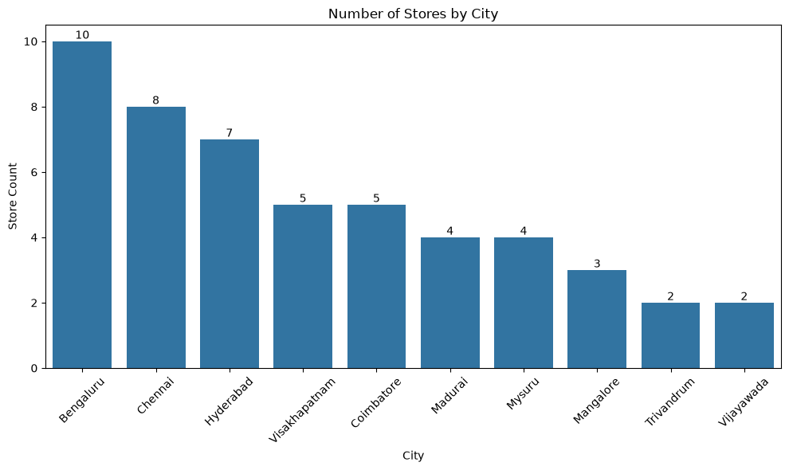
1. RETAIL FOOTPRINT
Store Distribution by City
Number of stores per city, sorted from highest to lowest
WHAT THE CHART SHOWS
Bengaluru leads with 10 stores, the largest footprint in the network.
Chennai (8) and Hyderabad (7) form the next tier, making these three cities the core network.
Visakhapatnam and Coimbatore follow with 5 stores each; Madurai and Mysuru have 4 each.
Mangalore (3), Trivandrum (2) and Vijayawada (2) have the smallest current footprint.
KEY INSIGHT
The network is concentrated in Bengaluru, Chennai and Hyderabad. Smaller cities like Trivandrum and Vijayawada represent clear white space for future store expansion.
Promotional Campaign Analysis
3

Slide 4
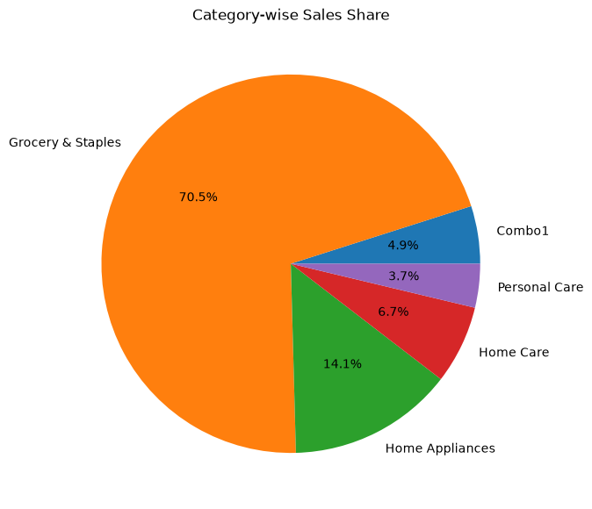
2. CATEGORY DEMAND
Sankranti: Post-Promotion Sales Mix
Share of quantity sold after promotion, by category
WHAT THE CHART SHOWS
Grocery & Staples contributes 70.5% of post-promotion units sold — the campaign's dominant category.
Home Appliances is a distant second at 14.1%.
Home Care (6.7%), Combo1 (4.9%) and Personal Care (3.7%) round out the mix.
Volume is heavily concentrated in essential, everyday products.
KEY INSIGHT
Grocery & Staples is the campaign's volume engine. Inventory availability for this category should be protected first during any promotion window.
Promotional Campaign Analysis
4

Slide 5
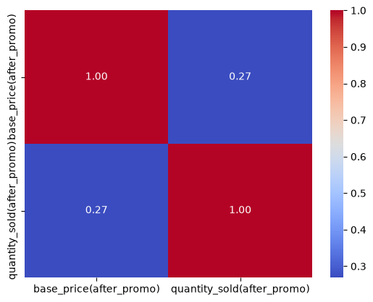
3. PRICING
Price vs. Post-Promotion Sales
Correlation between post-promotion base price and quantity sold
WHAT THE CHART SHOWS
The correlation between base price and quantity sold after promotion is +0.27 — a weak positive relationship.
Higher-priced products show only a slight tendency to sell more units.
Price alone explains only a small part of the variation in post-promotion sales.
Promotion type, category and product preference likely matter more than price positioning.
KEY INSIGHT
Pricing alone is not the main demand lever. Pair pricing decisions with targeted promotion design rather than relying on price cuts by themselves.
Promotional Campaign Analysis
5

Slide 6
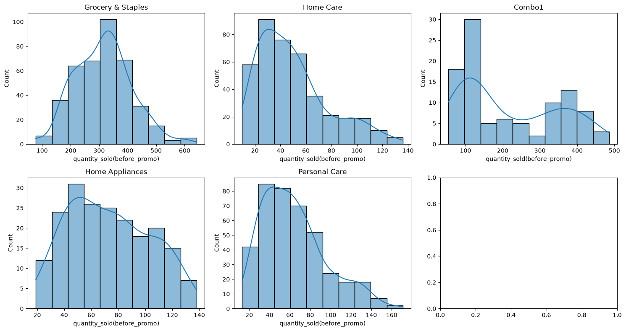
4. BASELINE DEMAND
Pre-Promotion Demand by Category
Distribution of quantity sold before promotion, by category
WHAT THE CHART SHOWS
Grocery & Staples clusters around 200–400 units, with a few products above 500.
Home Care (20–60) and Personal Care (30–80) are lower-volume and right-skewed.
Home Appliances spans roughly 30–120 units, showing wider demand variation.
Combo1 is bimodal, with peaks near 100 units and 350–400 units.
KEY INSIGHT
Categories have very different baseline demand shapes, which supports category- or SKU-level promotion design rather than one blanket discount.
Promotional Campaign Analysis
6

Slide 7
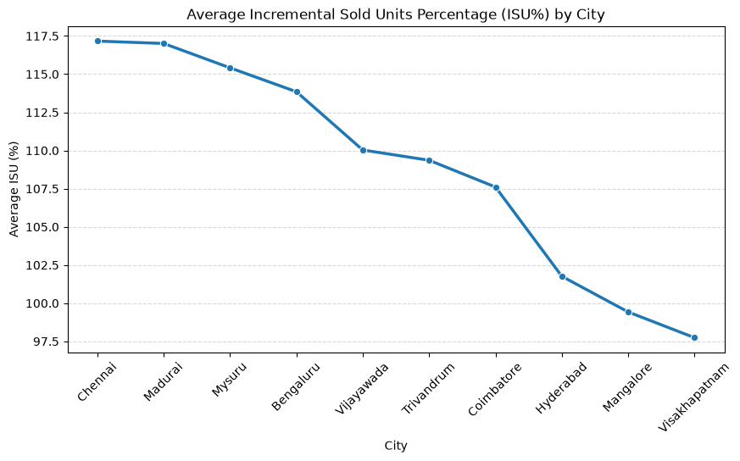
5. CITY RESPONSE
Incremental Sold Units % Across Cities
Average ISU% by city after promotion, highest to lowest
WHAT THE CHART SHOWS
Chennai leads at 117.17%, just ahead of Madurai at 117.01%.
Mysuru (115.41%) and Bengaluru (113.85%) also show strong uplift.
Hyderabad (101.76%) and Mangalore (99.42%) trail the top group.
Visakhapatnam is lowest at 97.74%, about 19.4 points below Chennai.
KEY INSIGHT
Promotion response varies meaningfully by city. Use Chennai, Madurai and Mysuru as benchmarks, and diagnose why Visakhapatnam and Mangalore respond more weakly.
Promotional Campaign Analysis
7

Slide 8
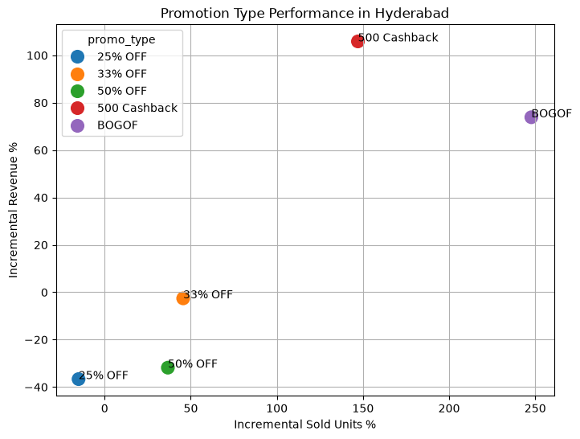
6. PROMOTION ECONOMICS
Hyderabad: Promotion Type Performance
Incremental sold units % vs. incremental revenue %, by promotion type
WHAT THE CHART SHOWS
BOGOF leads unit growth at ISU% 247.73%, and also delivers a strong IR% of 73.87%.
₹500 Cashback leads revenue growth at IR% 105.87%, with ISU% of 147.05%.
33% OFF and 50% OFF increase units but produce negative incremental revenue.
25% OFF underperforms on both metrics: ISU% −15.15% and IR% −36.65%.
KEY INSIGHT
BOGOF maximizes unit growth; ₹500 Cashback maximizes revenue uplift. Discount depth alone does not guarantee a good outcome — mechanic choice matters.
Promotional Campaign Analysis
8

Slide 9
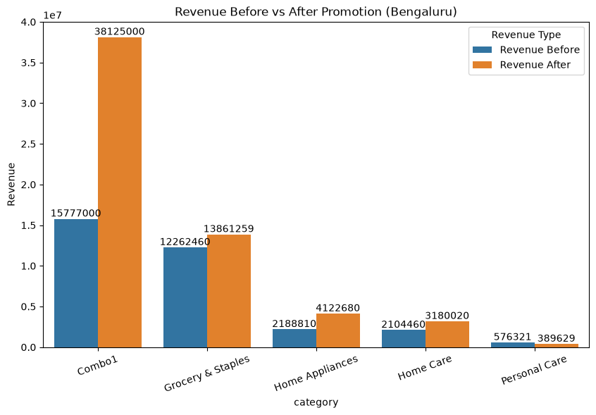
7. REVENUE IMPACT
Bengaluru: Revenue Before vs. After Promotion
Category-level revenue comparison, in ₹
WHAT THE CHART SHOWS
Combo1 rises from ₹15.78M to ₹38.13M, an uplift of about 141.6% — the standout performer.
Home Appliances grows from ₹2.19M to ₹4.12M (~88.3%); Home Care grows from ₹2.10M to ₹3.18M (~51.1%).
Grocery & Staples grows from ₹12.26M to ₹13.86M (~13.0%), a smaller uplift given its already-strong baseline.
Personal Care falls from ₹0.58M to ₹0.39M (~32.4%) — the only category with a post-promotion decline.
KEY INSIGHT
Promotions broadly lifted Bengaluru revenue, but Combo1's outsized gain and Personal Care's decline show why offers need to be set category by category.
Promotional Campaign Analysis
9

Slide 10
Executive Summary
Five takeaways from the store, category, city, promotion and revenue analysis
Retail footprint
Bengaluru has the largest store network at 10 stores; together with Chennai (8) and Hyderabad (7), these three cities form the core network.
Category demand
Grocery & Staples contributes 70.5% of Sankranti post-promotion units — by far the campaign's largest volume driver.
City response
Chennai posts the highest average ISU% at 117.17%; Visakhapatnam is lowest at 97.74%.
Promotion economics
In Hyderabad, BOGOF drives the largest unit uplift (ISU% 247.73%); ₹500 Cashback drives the largest revenue uplift (IR% 105.87%).
Revenue impact
In Bengaluru, Combo1 revenue rises from ₹15.78M to ₹38.13M (+141.6%), while Personal Care falls ~32.4%.
Promotional Campaign Analysis
10

Slide 11
Actionable Recommendations
Translating the observed patterns into promotional decisions
1
Protect the volume engine
Prioritize inventory availability and value-led offers for Grocery & Staples, since both baseline and post-promotion demand are dominant here.
2
Scale winning mechanics
Use BOGOF where the objective is maximum unit growth; use ₹500 Cashback when revenue uplift is the priority.
3
Localize by city
Use Chennai, Madurai and Mysuru as benchmarks, and investigate why Visakhapatnam and Mangalore respond less strongly.
4
Segment by demand shape
Treat Combo1's two demand clusters separately, and avoid blanket discounts across categories with very different demand patterns.
5
Fix underperformers
Rework Personal Care promotions and deep-discount mechanics like 25% OFF — both lost revenue despite the campaign.
Promotional Campaign Analysis
11

